Slide 1
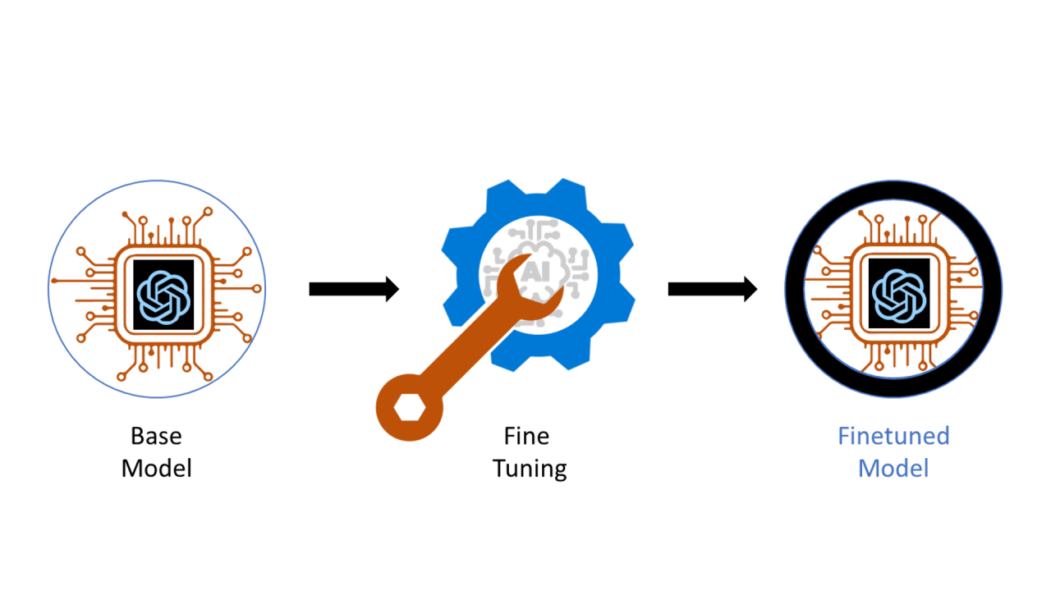
Labor market impacts of AI: A new measure and early evidence
3.25.2026

Slide 2
Labor market impacts of AI: A new measure and early evidence (Published March 5, 2026)
Abstract
Introduces “observed exposure” to measure AI job risk using real-world usage
AI usage is below its full potential (gap between capability vs actual use)
High-exposure occupations show slower projected job growth
Most exposed workers are older, female, highly educated, and higher-paid
No clear rise in unemployment since 2022 in exposed roles
Early signs of reduced hiring for younger workers in affected fields
1/12

Slide 3
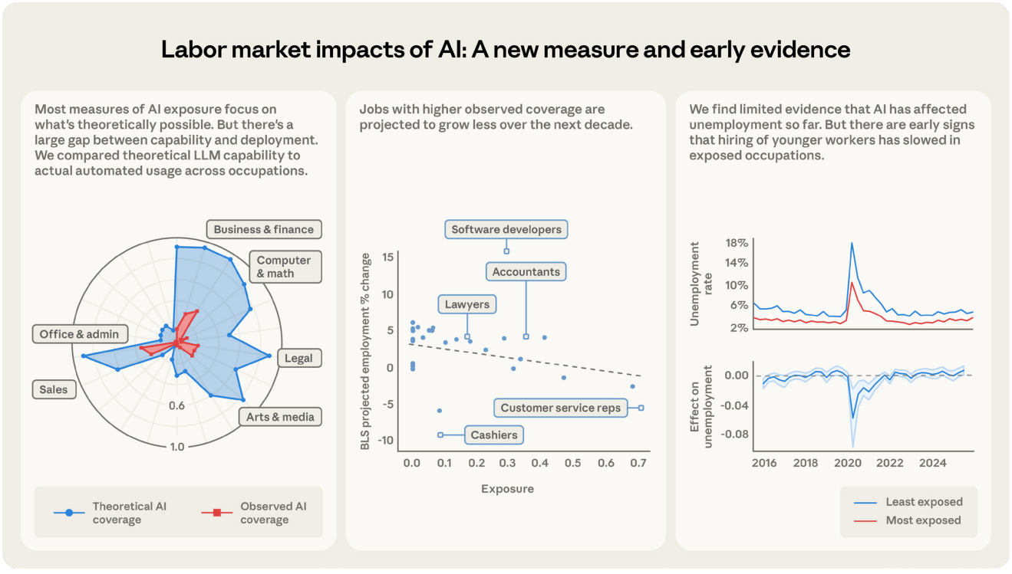
Labor market impacts of AI: A new measure and early evidence (Published March 5, 2026)
2/12
Notes:
Labor market impacts of AI: A new measure and early evidence
This slide summarizes the key findings of the study on AI and labor market impacts
Starting with the left chart, we see a clear gap between:
Theoretical AI capability (blue)
Actual AI usage (red)
This shows that while AI can perform many tasks, it is not yet widely adopted in practice
In the middle chart, there is a negative relationship between AI exposure and job growth
Occupations with higher AI exposure, like software development and accounting, are projected to grow more slowly
While lower-exposure roles may see more stable or even positive growth
On the right side, we examine unemployment trends over time
There is no clear increase in unemployment in highly exposed jobs
However, there are early signs of reduced hiring, especially among younger workers
👉 Overall takeaway: AI is not causing widespread job loss yet, but it is already influencing job growth patterns and hiring trends, with a significant gap between potential and actual use.

Slide 4
Labor market impacts of AI: A new measure and early evidence (Published March 5, 2026)
Method Overview & Key Insights
AI labor market impact is difficult to predict (past models often inaccurate)
Previous forecasts (e.g., offshoring, automation) overestimated job losses
Economic disruptions often show mixed or unclear effects
Introduces a new framework to measure AI’s real-world impact
Current data shows limited evidence of employment changes so far
Framework aims to track changes over time (early baseline)
Helps identify at-risk jobs before visible displacement occurs
3/12

Slide 5
Labor market impacts of AI: A new measure and early evidence (Published March 5, 2026)
Counterfactuals & AI Impact Measurement
Large shocks (e.g., COVID-19) make impacts easy to identify
AI effects are gradual and less visible (like internet or trade shifts)
Changes may be hidden by other economic factors (e.g., business cycles)
Uses comparisons between high vs low AI-exposed jobs to isolate effects
Exposure defined at the task level, not whole occupations
Combines AI capability + real-world usage data for analysis
4/12

Slide 6
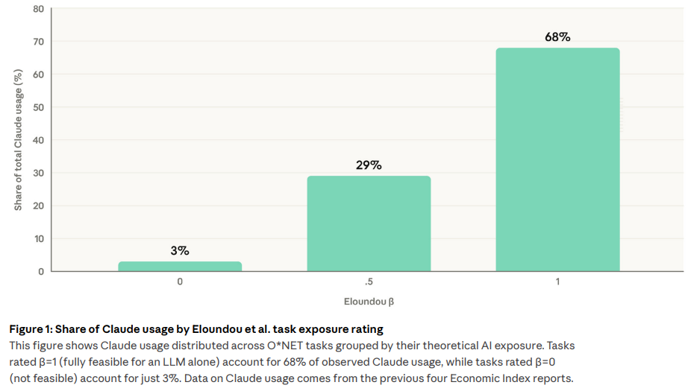
Labor market impacts of AI: A new measure and early evidence (Published March 5, 2026)
Share of Claude usage by Eloundou et al. exposure rating
5/12
Notes:
Measuring Exposure
This study measures AI exposure by combining three key data sources
First, the O*NET database, which lists tasks across ~800 occupations
Second, real-world AI usage data from the Anthropic Economic Index
Third, theoretical exposure scores from Eloundou et al. (2023)
Eloundou’s model scores tasks based on how much AI can improve speed:
1 = AI alone can double task speed
0.5 = AI needs additional tools
0 = no meaningful impact
However, actual AI use is lower than theoretical potential
This gap exists due to:
Legal restrictions
Technical limitations
Need for human verification
Despite this, there is a strong correlation between theory and practice
In fact, 97% of observed AI tasks are considered feasible by the model
👉 Key takeaway: The framework bridges the gap between what AI can do and what it is actually doing in the workplace

Slide 7
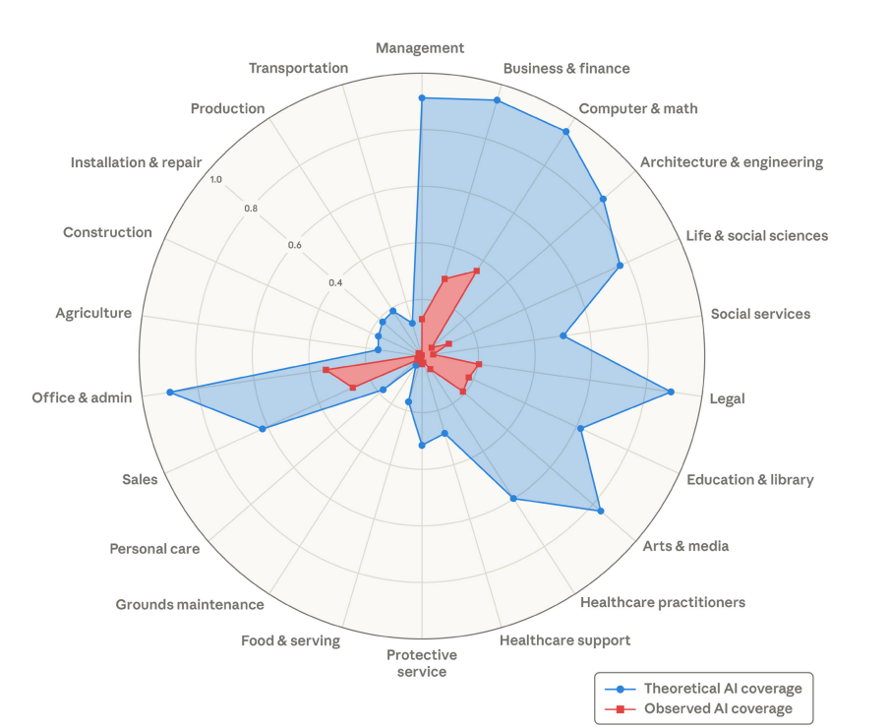
Labor market impacts of AI: A new measure and early evidence (Published March 5, 2026)
Share of Claude usage by Eloundou et al. exposure rating
6/12
Notes:
Share of Claude usage by Eloundou et al. exposure rating
This diagram compares theoretical AI capability (blue) with actual observed usage (red) across different job categories
The most important takeaway is the large gap between what AI can do and what it is currently doing
Many occupations—especially computer & math, business & finance, and legal—have very high theoretical exposure, meaning AI could perform a large share of tasks
However, the observed usage is much lower across all categories, showing that AI adoption is still in early stages
We also see that knowledge-based professions have the highest exposure, while manual or physical jobs like agriculture, construction, and transportation have very low exposure
This supports the idea that AI is primarily impacting cognitive and white-collar work, rather than manual labor
👉 Key takeaway: There is a significant gap between AI potential and real-world use, meaning the full labor market impact of AI has not yet been realized but could increase as adoption grows

Slide 8
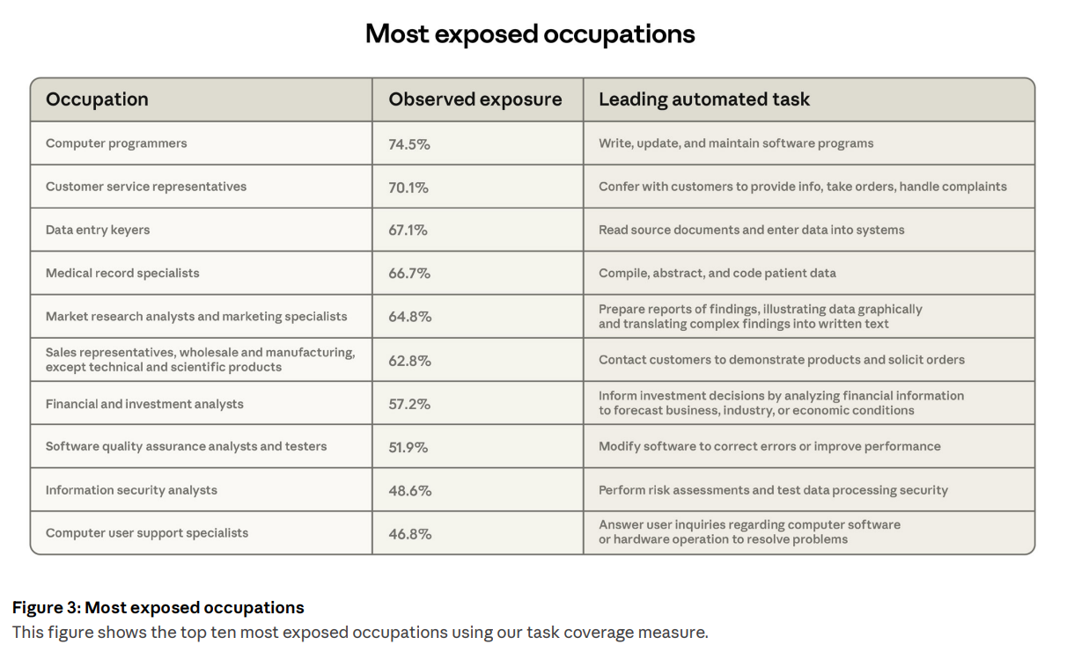
Labor market impacts of AI: A new measure and early evidence (Published March 5, 2026)
7/12
Notes:
Most exposed occupations
This table highlights the top 10 occupations most exposed to AI, based on observed real-world usage rather than just theory
At the top, we see computer programmers (74.5%) and customer service representatives (70.1%), indicating that a large portion of their tasks can already be performed or supported by AI
Other highly exposed roles include:
Data entry and medical record specialists → tasks involve structured data handling
Market research and financial analysts → tasks involve analyzing and summarizing information
These are all information-processing and text-based tasks, which AI handles well
A key pattern is that AI is automating specific tasks, not entire jobs
For example, in customer service, AI can handle routine queries, but not complex human interactions
Importantly, exposure does not mean immediate job loss
Instead, it indicates where AI is most likely to change how work is done
👉 Key takeaway: AI is currently impacting cognitive, repetitive, and data-driven roles the most, especially in tech, business, and administrative work, but mainly through task-level automation rather than full job replacement

Slide 9
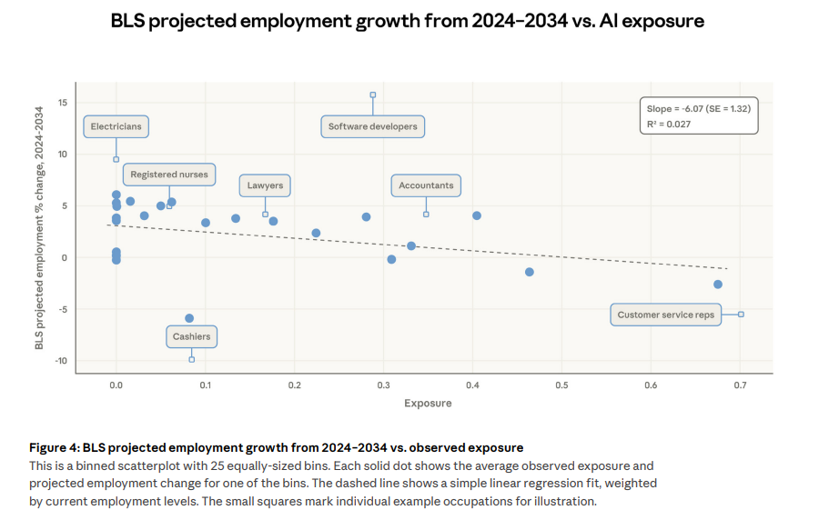
Labor market impacts of AI: A new measure and early evidence (Published March 5, 2026)
8/12
Notes:
BLS projected employment growth from 2024–2034 vs. AI exposure
This figure shows the relationship between AI exposure and projected job growth from 2024–2034
The key trend is the downward-sloping line, which indicates a negative relationship
In simple terms: 👉 Jobs with higher AI exposure are expected to grow more slowly
For example:
Customer service representatives show high exposure and negative growth
Cashiers also show low or declining growth
In contrast:
Electricians and nurses, which have low AI exposure, show strong positive growth
However, the relationship is relatively weak (low R² value)
This means AI exposure is not the only factor affecting job growth—other economic factors also play a role
Importantly, this aligns with the paper’s finding that AI is influencing future job trends, even if it hasn’t yet caused widespread unemployment
👉 Key takeaway: AI exposure is associated with slower future job growth, but its overall impact is still emerging and not yet dominant

Slide 10
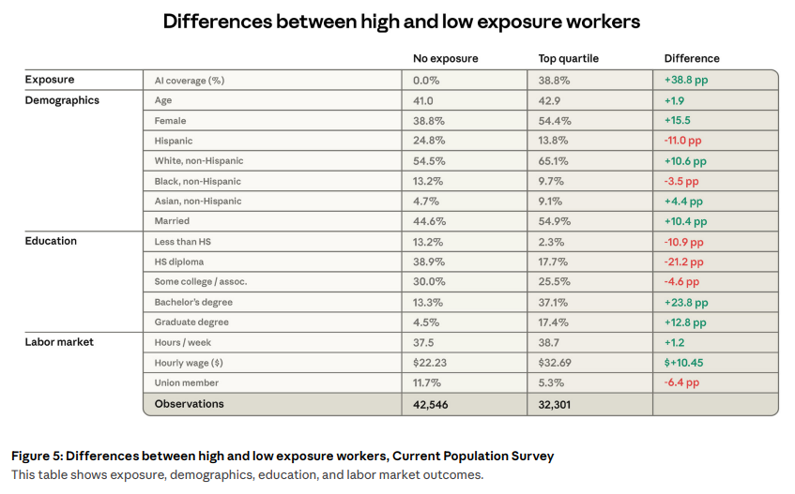
Labor market impacts of AI: A new measure and early evidence (Published March 5, 2026)
9/12
Notes:
Differences between high and low exposure workers
This table compares workers with no AI exposure vs. those in the highest exposure group
Starting with demographics:
Highly exposed workers are slightly older and much more likely to be female
They are also more likely to be white or Asian, and more likely to be married
The biggest difference is in education:
High-exposure workers are far more likely to have bachelor’s and graduate degrees
While low-exposure workers are more likely to have only high school or less education
In terms of the labor market:
High-exposure workers earn significantly more—about 47% higher wages on average
They also work slightly more hours but are less likely to be unionized
This challenges traditional views of automation: 👉 AI is not primarily targeting low-skill jobs, but rather high-skill, knowledge-based professions
👉 Key takeaway: AI exposure is concentrated among higher-paid, highly educated workers, meaning the impact of AI is shifting toward white-collar and professional roles, rather than manual labor

Slide 11
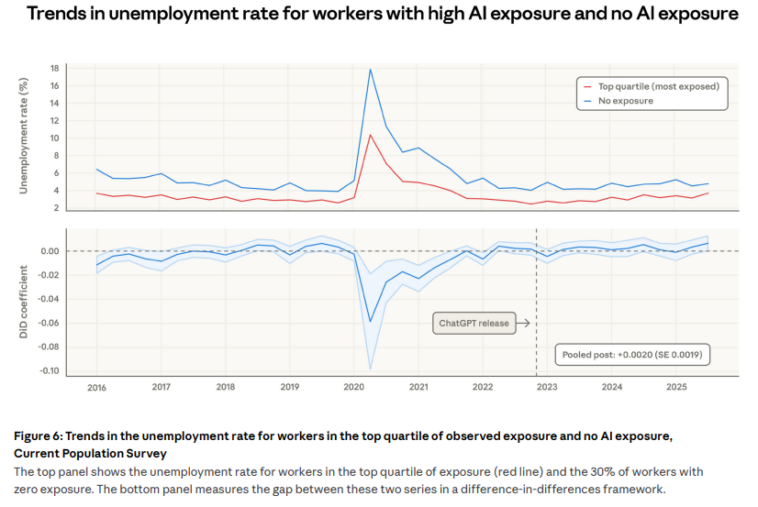
Labor market impacts of AI: A new measure and early evidence (Published March 5, 2026)
10/12
Notes:
Trends in unemployment rate for workers with high AI exposure and no AI exposure
This figure compares unemployment trends between high AI-exposure workers (red) and low/no exposure workers (blue) over time
In the top graph, both groups follow very similar unemployment patterns, including the sharp spike during COVID-19
Importantly, after 2022—when AI tools became widespread—there is no clear divergence between the two groups
The bottom graph uses a more rigorous method called difference-in-differences
This measures whether AI exposure caused any significant change in unemployment
The result stays very close to zero, meaning: 👉 No strong evidence that AI has increased unemployment so far
However, the paper highlights an important nuance:
There is some evidence of reduced hiring, especially for younger workers entering exposed fields
👉 Key takeaway: AI has not yet led to widespread job losses, but it may be affecting hiring patterns and entry into the workforce, suggesting early-stage labor market impacts

Slide 12
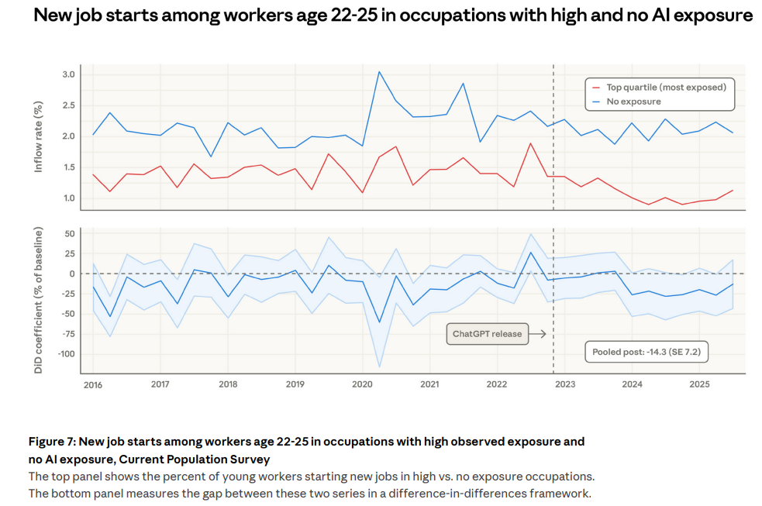
Labor market impacts of AI: A new measure and early evidence (Published March 5, 2026)
11/12
Notes:
New job starts among workers age 22–25 in occupations with high and no AI exposure
This figure looks at new job entry rates for young workers aged 22–25, comparing high AI-exposure jobs (red) vs low/no exposure jobs (blue)
In the top graph, we see that young workers consistently enter low-exposure jobs at higher rates than high-exposure ones
After around 2022 (when AI tools like ChatGPT became widespread), the gap becomes more noticeable
The bottom graph shows a difference-in-differences analysis
This confirms a decline in job entry for young workers in AI-exposed occupations
The study estimates about a ~14% drop in hiring rates for this group
Importantly, this does not mean jobs are disappearing, but rather: 👉 Companies may be hiring fewer entry-level workers 👉 AI is likely replacing routine beginner tasks
This supports a key idea from the paper:
AI’s early impact is on hiring, not layoffs
👉 Key takeaway: AI is beginning to affect the labor market by reducing entry opportunities for young workers, especially in high-exposure fields—making early career access more difficult

Slide 13
Labor market impacts of AI: A new measure and early evidence (Published March 5, 2026)
Discussion
Introduces a new measure of AI exposure combining theory + real usage
Identifies highly exposed roles:
Programmers
Customer service
Financial analysts
No clear impact on unemployment in highly exposed jobs
Early evidence of reduced hiring among young workers (age 22–25)
Framework provides a baseline to track AI’s future labor market effects
Designed to be updated as AI usage and employment data evolve
Limitations / Future Directions:
Current data is early and incomplete
Exposure metrics may need updating with newer AI capabilities
Further research needed on graduates entering AI-exposed fields
12/12

Slide 14

Labor market impacts of AI: A new measure and early evidence (Published March 5, 2026)
QUESTIONS

Slide 15
END
3.25.2026

